Slide 1
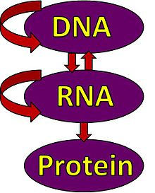
The
Central Dogma of Molecular Biology

Slide 2
DNA Replication
Reproduction is fundamental to all living systems
Regardless of the reproductive mechanism (asexual or sexual) a method must exist to transfer genetic material from one generation to the next.
DNA must be copied (replicated) in a manner that minimizes mistakes.
Damage to DNA must be repaired to prevent that damage from being transferred to the next generation.

Slide 3
Replication of DNA
Three theories were suggested:
Semi-conservative replication
produce molecules with both old and new DNA - each molecule would be composed of one old strand and one new one.
Conservative replication
intact the original DNA molecule and generate a completely new molecule.
Dispersive replication
produce two DNA molecules with sections of both old and new DNA interspersed along each strand.

Slide 4
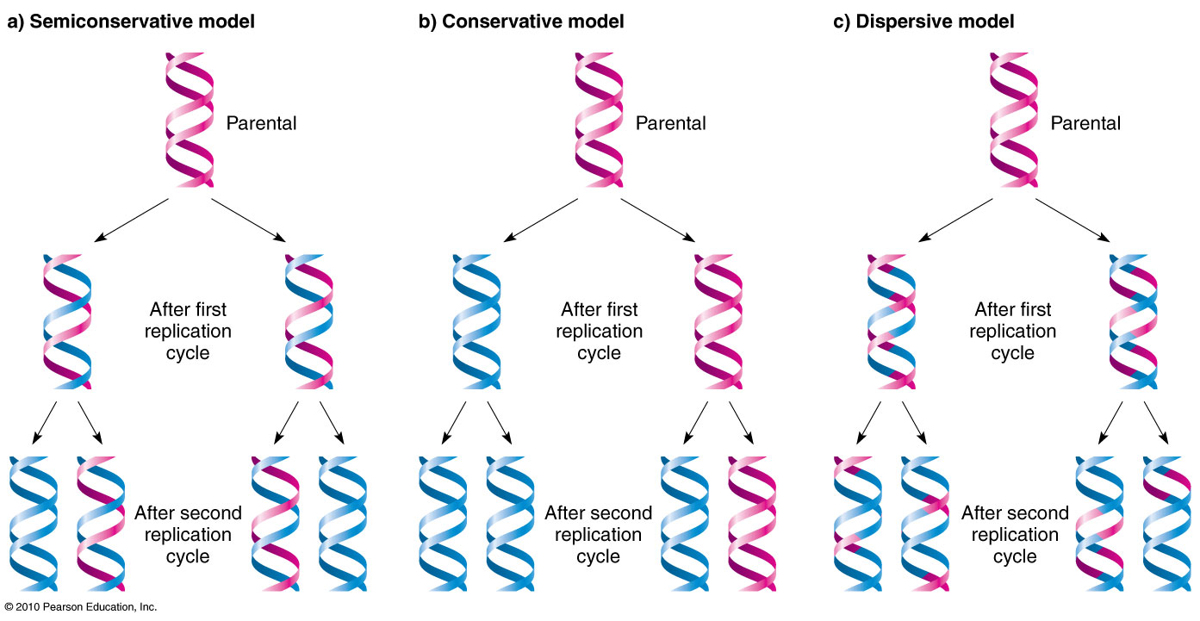
Replication of DNA

Slide 5
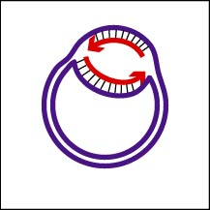
DNA Replication
Begins at Origins of Replication
Two strands open forming Replication Forks (Y-shaped region)
New strands grow at the forks
Unwinding enzymes called DNA helicases cause the two parent DNA strands to unwind and separate from one another at the origin of replication to form two "Y"-shaped replication forks.
DNA replication is bidirectional from the origin of replication
DNA replication occurs in both directions from the origin of replication
3’
5’
Parental DNA Molecule
Replication
Fork
3’
5’

Slide 6
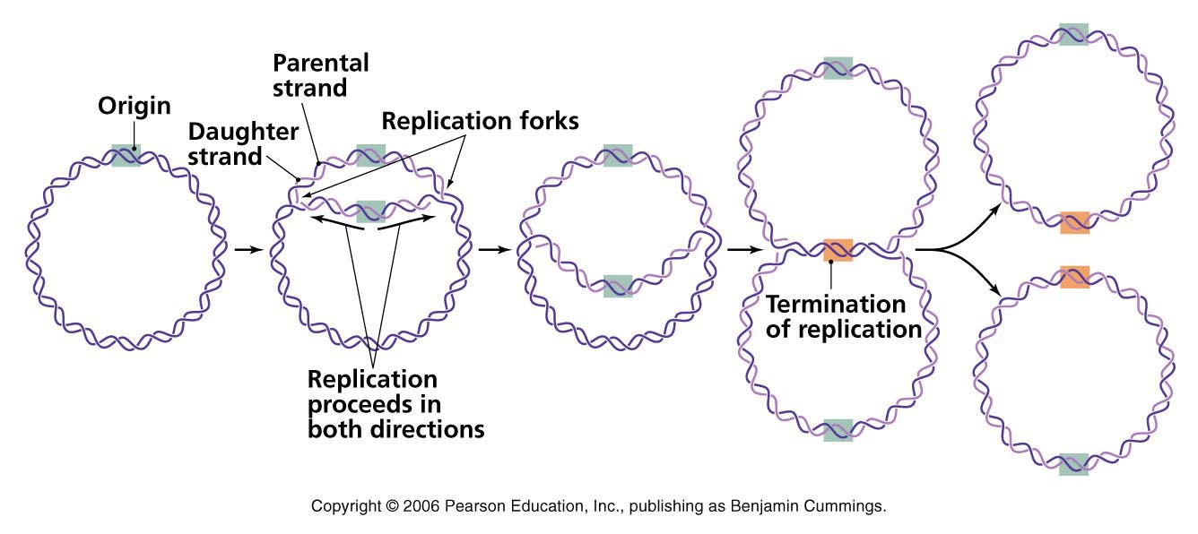

Slide 7
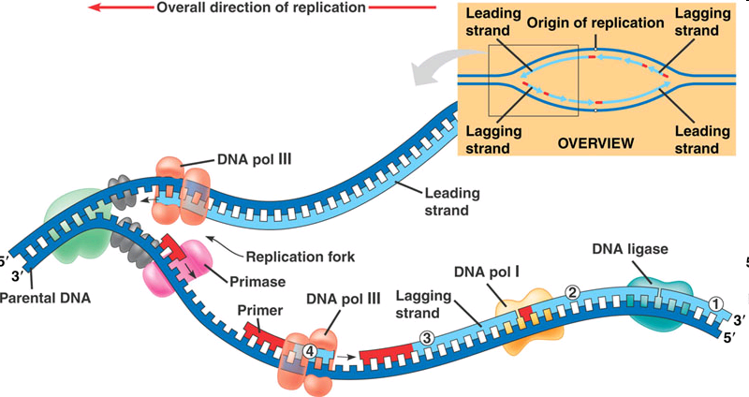
Replication Fork

Slide 8
Enzymes and core proteins in DNA replication
Helicase unwinds and separates the 2 DNA strands by breaking the weak hydrogen bonds (requires energy)
Single-Strand Binding Proteins attach and keep the 2 DNA strands separated and untwisted
Topoisomerase attaches to the 2 forks of the bubble to relieve stress on the DNA molecule as it separates
Before new DNA strands can form, there must be RNA primers present to start the addition of new nucleotides
Primase is the enzyme that synthesizes the RNA Primer
DNA polymerase can then add the new nucleotides
DNA ligase seals nick via phosphodiester linkage

Slide 9
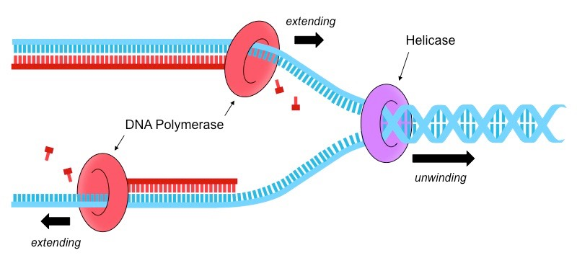
DNA Replication
Enzyme Helicase unwinds and separates the 2 DNA strands by breaking the weak hydrogen bonds
Translocate along single strand in 5’->3’ or 3’-> 5’ direction by hydrolyzing ATP
Single-Strand Binding Proteins attach and keep the 2 DNA strands separated and untwisted
SSB proteins

Slide 10
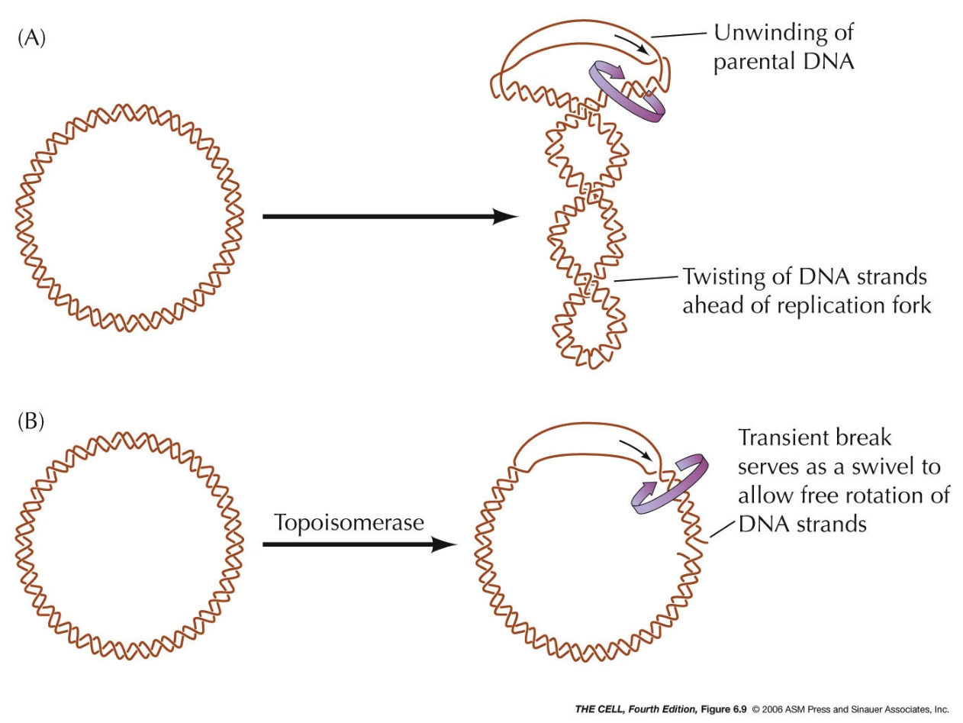
DNA Replication
Enzyme Topoisomerase attaches to the 2 forks of the bubble to relieve stress on the DNA molecule as it separates
Makes a cut in one strand, passes other strand through it. Seals gap.
Result: induces positive supercoiling as strands are separated, allowing replication machinery to proceed.

Slide 11
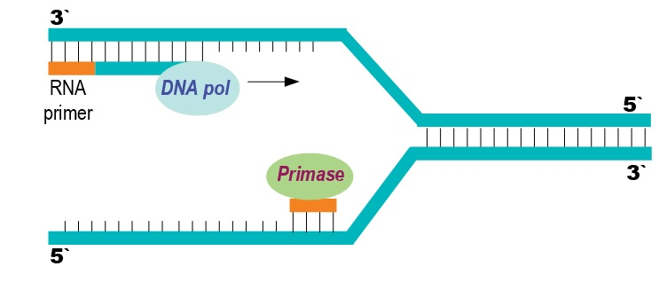
DNA Replication
Before new DNA strands can form, there must be RNA primers present to start the addition of new nucleotides
Primase is the enzyme that synthesizes the RNA Primer
DNA polymerase can then add the new nucleotides

Slide 12
DNA Replication
DNA polymerase can only add nucleotides to the 3’ end of the DNA
This causes the NEW strand to be built in a 5’ to 3’ direction
5’
3’
5’
RNA
Primer
DNA Polymerase
Nucleotide
Direction of Replication

Slide 13
Functions of DNA polymerase
1. 5'→3' (forward) DNA-Dependent DNA polymerase activity, requiring a 3' primer site and a template strand (DNA pol 1,3)
2. 3'→5' (reverse) exonuclease activity that mediates proofreading (DNA pol 1, 3)
3. 5'→3' (forward) exonuclease activity mediating nick translation during DNA repair (DNA pol 1).
Type of DNA polymerase | Function
Type 1 | Removal of primers, gap filling of okazaki fragments, exonuclease ( both direction)
Type 2 | DNA repair
Type 3 | Primary for DNA replication, proofreading and exonuclease (3’-5’)

Slide 14
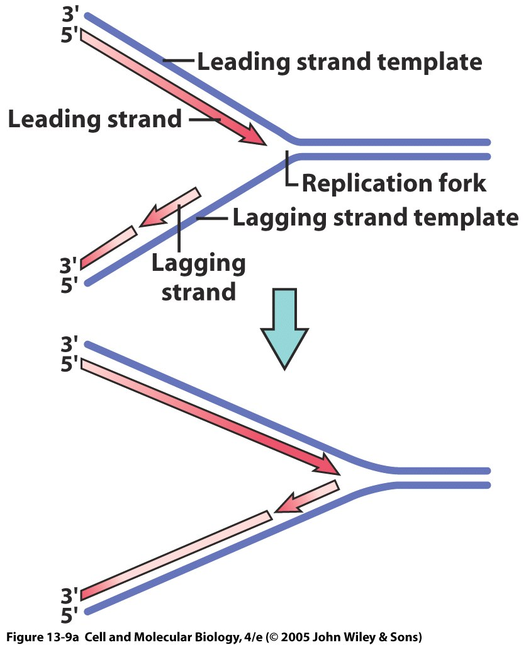
Leading & Lagging strand
The strand growing toward the fork grows continuously in 5'—>3' direction (leading strand) as the replication fork advances
2. The strand growing away from fork (lagging strand) grows discontinuously as Okazaki fragments

Slide 15
Synthesis of the New DNA Strands
The Leading Strand is synthesized as a single strand from the point of origin toward the opening replication fork
5’
3’
5’
RNA
Primer
Nucleotides
DNA Polymerase

Slide 16
Synthesis of the New DNA Strands
The Lagging Strand is synthesized discontinuously against overall direction of replication
This strand is made in MANY short segments It is replicated from the replication fork toward the origin
5’
Leading Strand
3’
3’
5’
DNA Polymerase
RNA Primer
5’
3’
3’
5’
Lagging Strand

Slide 17
Lagging Strand Segments
Okazaki Fragments - series of short segments on the lagging strand
Must be joined together by an enzyme
DNA
Polymerase
Okazaki Fragment
RNA
Primer
5’
3’
3’
5’
Lagging Strand

Slide 18
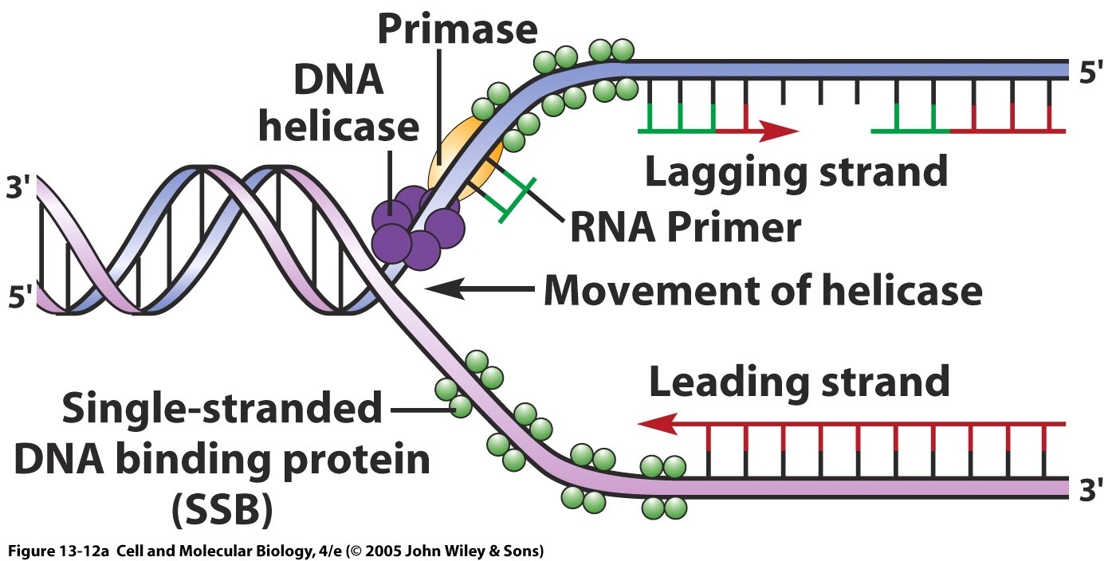
Replication of Strands
Replication Fork
Point of Origin

Slide 19
Joining of Okazaki Fragments
The enzyme Ligase joins the Okazaki fragments together to make one strand
DNA ligase
5’
Okazaki Fragment 1
Okazaki Fragment 2
3’
3’
5’
Lagging Strand

Slide 20
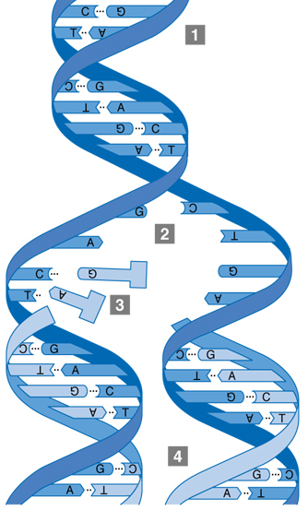
Replication process
Double-stranded DNA unwinds.
The junction of the unwound
molecules is a replication fork.
A new strand is formed by pairing
complementary bases with the
old strand.
Two molecules are made.
Each has one new and one old
DNA strand.

Slide 21
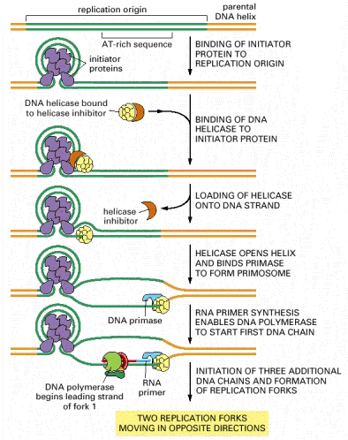
Initiation of Replication
Replication initiated at specific sites: Origin of Replication (ori)
Two Types of initiation:
De novo –Synthesis initiated with RNA primers. Most common.
Covalent extension—synthesis of new strand as an extension of an old strand (“Rolling Circle”)
Notes:
Replication initiated at specific sites: Origin of Replication (ori)
Two Types of initiation:
De novo –Synthesis initiated with RNA primers. Most common.
Covalent extension—synthesis of new strand as an extension of an old strand (“Rolling Circle”)

Slide 22
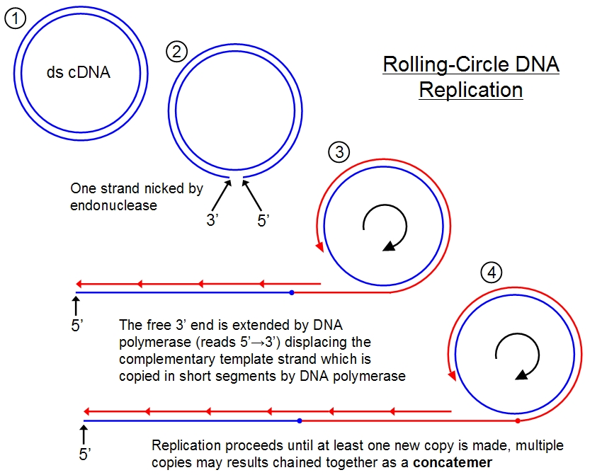

Slide 23
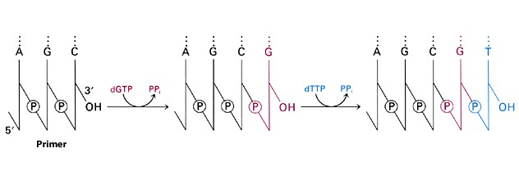
Extending the Chain
dNTPs are added individually
Sequence determined by pairing with template strand
DNA has only one phosphate between bases, so why use dNTPs?
Chain Elongation in the 5’→ 3’ direction
Notes:
Deoxyribonucleoside triphosphates are the building blocks of DNA. However, a complete polynucleotide strand of DNA has only one phosphate group and that through this phosphate group each nucleotide is attached to the next. Why then is the substrate a triphosphate instead of just a monophosphate? The answer to this question lies in the chemistry underlying the addition of nucleotides to a growing daughter strand of DNA.

Slide 24
Termination of Replication
DNA replication begins at the origin and travels in both directions.
Termination at a specific locus, when it occurs, involves the interaction between two components:
(1) a termination site sequence in the DNA,
(2) a protein which binds to this sequence to physically stop DNA replication (Ter protein)
Telomere and telomerase (eukaryotes)

Slide 25
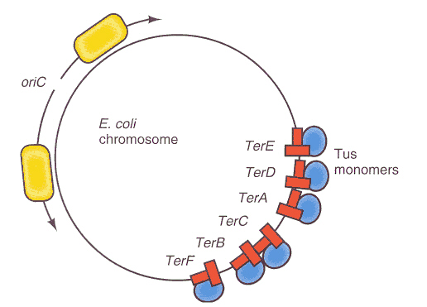
Termination of Replication
Tus Protein-arrests replication fork motion
Occurs @ specific site opposite ori c
~350 kb
Flanked by 6 nearly identical 23 bp terminator (ter) sites
Notes:
Occurs @ specific site opposite ori c
~350 kb
Flanked by 6 nearly identical non-palindromic*, 23 bp terminator (ter) sites
* Significance?
Ter sites are polar, providing directionality. Allow replication forks to enter the terminus, but not leave it.
Tus ( Terminator Utilization Substance) Protein ---arrests replication fork motion. Is a 309 aa monomer.
Tus Binds to terminator sites, probably interacts with helicase ∴stops replication fork.
NOTE: Mutants that lack rep terminus still re[plicate DNA and replication stops.
Termination system very highly conserved in prokaryotes
Final step: unlinking circular DNA, probably by a topoisomerase

Slide 26
Features of DNA Replication
DNA replication is semiconservative
Each strand of template DNA is being copied.
DNA replication is semidiscontinuous
The leading strand copies continuously
The lagging strand copies in segments (Okazaki fragments) which must be joined
DNA replication is bidirectional
Bidirectional replication involves two replication forks, which move in opposite directions

